Slide 1
IMPACT OF GLOBALIZATION ON CONSUMERS
Introduction and Background Information
Positive Trends and Benefits of Globalization to Consumers
Negative Effects of Globalization
Conclusion and Recommendations
Future Research
References

Slide 2
Introduction and Background
Globalization refers to increased integration of the world system
Profound factors that enhance globalization include;-
Market Liberalization
Technological and ICT Advancement
International Trade
The world has become a global village: Marketing trends in one region, affects the rest of the world

Slide 3
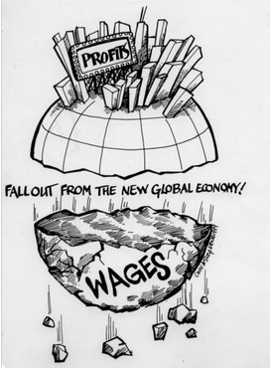
Illustration of the Trends in Globalization
Globalization presents a double-edge sword scenario with equal positive and negative effects

Slide 4
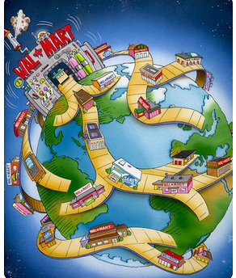
Positive Trends toward Consumers
Integration of the international market
For example, a consumer in South Africa can purchase a merchandise from Wal-Mart store in Virginia using internet and have the same good deliver within the shortest time possible

Slide 5
Positive Trends toward Consumers (cont…ed)
2. Influence on Export Performance and Balance of Trade
Advanced ICT infrastructures enhance efficiency in regional markets and compete favorably to the international markets
3. New Consumer Cultures and Lifestyles
Proliferation of Western cultures and lifestyles in other regions
For example, a consumer wears a Nike or GAP merchandise perceive unique the images of modernity, progress, or success

Slide 6
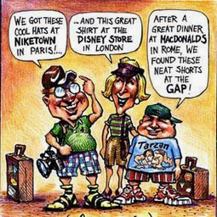
Positive Trends toward Consumers (cont…ed)
4. Consumerism Models
Consumers are more empowered and exhibits awareness about the quality, fair pricing, and satisfaction

Slide 7

Positive Trends toward Consumers (cont…ed)
5. Rebirth of Local Industries
Ease of labor, capital, and entrepreneurial factors of production
Increased competition from global brand spurs innovation and development
Ethnocentric consumer values
Economic spillovers

Slide 8
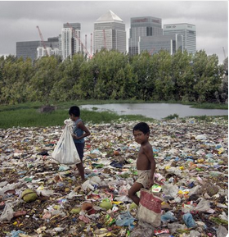
Negative Trends and Effects of Globalization
Predatory Dumping
Negative effects on domestic economy
Predatory dumping refers to abuse of economic dominance by an foreign country by charging its exports below the ‘natural value’
China has been accused of dumping its surpluses into the African nations and other developing economies

Slide 9

Negative Trends and Effects of Globalization (cont...ed)
2. Loss of Jobs and Outsourcing
Unrestricted movement of capital and labor have led to outsourcing of production processes to offshore sites
Result in retrenchment and layoffs

Slide 10
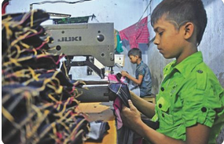
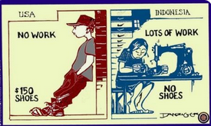
Negative Trends and Effects of Globalization (Cont…ed)
3. Use of Sweatshops, Child labor, and Exploitation
Trade and consumer unions have relinquished their influences to multinational entities (MNCs)
Liberalization facilitates MNCs to engage in marketing malpractices because of lenient Trade Laws and Competition Laws
Nike, Inc. has been accused of engaging in exploitative practices in Indonesia
Consumers can resent MNCs that engage in malpractices

Slide 11
Conclusion and Recommendations
The globalization phenomenon elicit fundamental paradigm shifts in the international marketing
Benefits impacts and negative effects necessitates structural reforms
For example, a shift in marketing philosophies from ‘seller-focused’ to consumer-centric approaches
A strategic marketer and a rational consumer ought to leverage on the numerous benefits of the globalization to offset the negative effects

Slide 12
Future Research
Globalization phenomenon endeavor to influence various human aspects
Therefore, research on the influence of product-market development using R&D has become a significant lacuna
Notably, strategic marketers need to enhance the competitiveness of their local merchandises
Innovations and development in the developing nations can curb predatory dumping because the indigenous goods can compete favorably with the global goods

Slide 13
References
Amadeo, K. (August 2, 2018). “Trade dumping and its consequencies,” The Balance
Fels, A. (2011). Globalization and competition policy, Sydney, AU: Australian Competition and Consumer Commission
Cleveland, M., Laroche, M., Naghavi, P., & Shafia, M.(2017). Globalization, culture, consumer dispositions, and consumption: The case of Iran. In The Customer is NOT Always Right? Marketing Orientationsin a Dynamic Business World (pp. 340-340). Springer, Cham
Gupta, N. (2011). Globalization does lead to change in consumer behavior: an empirical evidence of impact of globalization on changing materialistic values in Indian consumers and its aftereffects. Asia Pacific Journal of Marketing and Logistics, vol.23, issue3, pp.251-269.
Jackson, P. (2014). Local Consumption Cultures in a Globalizing World. Transactions of the Institute of British Geographers, vol.29, issue 2,pp. 165-178
Jain, S. (2016). Globalization and its impact on consumer culture and competition policy,New Dehli: Delhi High Court
Karlsson, C., Cornett, A., & Wallin, T. (2018). Globalization, International Spillovers and Sectoral Changes: Implications for Regions and Industries, Cheltenham, UK : Edward Elgar Pub
Nhlabatsi, R. (March 6, 2014). “Cheap Chinese import in Africa: Implications and remedies,” ThePolity.org
Potter, P. & Biukovic, L. (2011). Globalization and local adaptation in international trade law. Vancouver: UBC Press.
Ruggieri, A & Silvestri, C. & Piccarozzi, M. (2014). Consumerism, market analysis, and impact on business plan definition. Pp. 425-457

